Slide 1
Sorting Algorithm with Example
Presented By
Hasan Abdullah
Lecturer
Department of Computer Science and Engineering

Slide 2
Course Outline
Insertion Sort
Bubble Sort
Selection Sort

Slide 3
Why Study Sorting Algorithms?
There are a variety of situations that we can encounter
  Do we have randomly ordered keys?
  Are all keys distinct?
  How large is the set of keys to be ordered?
  Need guaranteed performance?
Various algorithms are better suited to some of these situations

Slide 4
Insertion Sort
while some elements unsorted:
  Using linear search, find the location in the sorted portion where the 1st element of the unsorted portion should be inserted
  Move all the elements after the insertion location up one position to make space for the new element
45
38
60
45
66
60
45
66
79
47
13
74
36
21
94
22
57
16
29
81
the fourth iteration of this loop is shown here

Slide 5
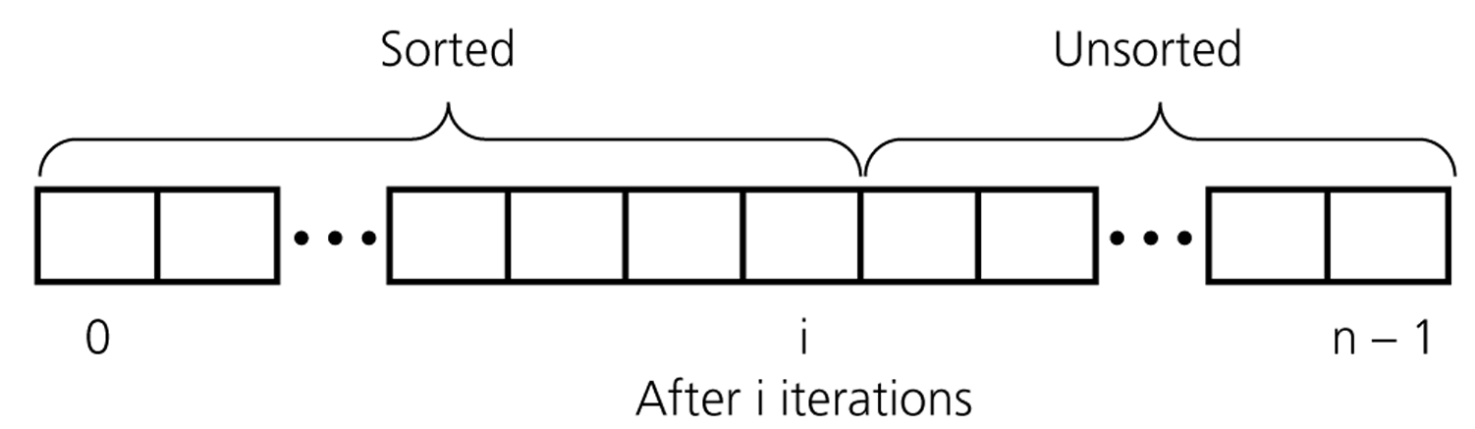
An insertion sort partitions the array into two regions

Slide 6
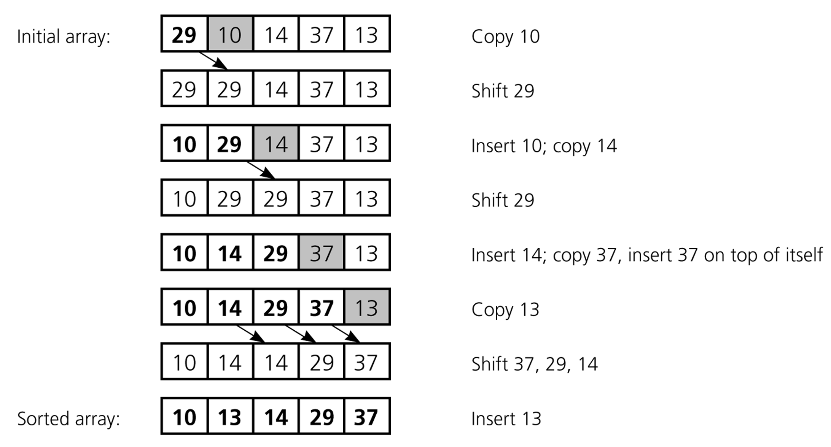
Insertion Sort Program Example
An insertion sort of an array of five integers

Slide 7
Insertion Sort Example
3 7 4 9 5 2 6 1
3 7 4 9 5 2 6 1
3 7 4 9 5 2 6 1
3 4 7 9 5 2 6 1
3 4 7 9 5 2 6 1
3 4 5 7 9 2 6 1
2 3 4 5 7 9 6 1
2 3 4 5 6 7 9 1
1 2 3 4 5 6 7 9
An insertion sort of an array of 8 integers

Slide 8
Insertion Sort Algorithm
Insertion_Sort (Input, Max):
Step 1: i ← 1
Step 2: X=Input [i] and j ← i
Step 3: while j > 0 and Input[j-1] > X)
Input [j] ← Input [j-1]
j ← j - 1
Step 4: if i > max then
go to step 5
Else
i← i + 1
go to step 2
Step 5: Return
outer loop
outer times
inner loop
inner times

Slide 9
Insertion Sort - Summary
Advantages
  Good running time for “almost sorted” arrays Θ(n)
Disadvantages
  Θ(n²) running time in worst and average case
  ≈ n²/2 comparisons and exchanges

Slide 10
Bubble Sort
Idea:
  Repeatedly pass through the array
  Swaps adjacent elements that are out of order
Easier to implement, but slower than Insertion sort
i
8
4
6
9
2
3
1
j

Slide 11
Example
8
4
6
9
2
3
1
1
8
4
6
9
2
3
i = 1
j
i = 2
j
8
4
6
9
2
1
3
1
2
8
4
6
9
3
i = 1
j
i = 3
j
8
4
6
9
1
2
3
1
2
3
8
4
6
9
i = 1
j
i = 4
j
8
4
6
1
9
2
3
1
2
3
4
8
6
9
i = 1
j
i = 5
j
8
4
1
6
9
2
3
1
2
3
4
6
8
9
i = 1
j
i = 6
j
8
1
4
6
9
2
3
1
2
3
4
6
8
9
i = 1
j
i = 7
1
8
4
6
9
2
3
j
i = 1
j

Slide 12
Bubble Sort Algorithm
Bubble_Sort (Input, Max):
Step 1: i ← 1
Step 2: j ← max
Step 3: while j > i then
if Input [j] < Input [j-1] then
Swap (Input [j] , Input [j-1] )
j ← j - 1
Step 4: if i > max then
go to step 5
else
i← i + 1
go to step 2
Step 5: Return
outer loop
inner loop
inner times
inner times

Slide 13
Bubble Sort: analysis
After the first traversal (iteration of the main loop) – the maximum element is moved to its place (the end of array)
After the i-th traversal – largest i elements are in their places
Complexity Same as Insertion Sort

Slide 14
Selection Sort
Idea:
  Find the smallest element in the array
  Exchange it with the element in the first position
  Find the second smallest element and exchange it with the element in the second position
  Continue until the array is sorted
Disadvantage:
  Running time depends only slightly on the amount of order in the file

Slide 15
Example
8
4
6
9
2
3
1
1
2
3
4
9
6
8
1
4
6
9
2
3
8
1
2
3
4
6
9
8
1
2
6
9
4
3
8
1
2
3
4
6
8
9
1
2
3
9
4
6
8
1
2
3
4
6
8
9

Slide 16
Selection Sort Algorithm
Selection_Sort (Input, Max):
Step 1: i ← 1
Step 2: do smallest ← j
Step 3: for j=i to max
if Input [j] < Input [smallest] then
smallest ← j
Swap (Input [j] , Input [smallest] )
Step 4: if i > max-1 then
go to step 5
else
i← i + 1
go to step 2
Step 5: Return
outer loop
inner loop
inner times
inner times

Slide 17
Any Question?
Thanks To Everybody

